Slide 1

OPIM 609: Final Project
Team 6: Marc Torchio, Peter Vail, Ruth Kaplan, Xue (Tracy) Feng, Manny Jean

Slide 2



Goal: evaluating hotel customer satisfaction
In this presentation, we evaluate customer review themes using text analysis
Review data is based on 420,785 Yelp customer reviews, a user generated business review site
Insights from target customers provide us insight to consider best practices to optimize marketing and operation strategy

Slide 3
Leverage topic modeling on customer reviews
Import data from database
Process review data by standardizing formatting, removing stop words, removing fake reviews, hyper-parameter tuning, tokenizing and vectorizing
Leverage topic modeling to take unstructured approach to determining emerging themes
Determine differences across differing levels of customer satisfaction

Slide 4
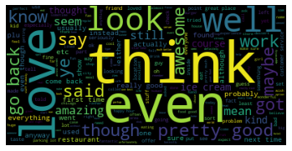
What topics do reviewers tend to bring up in general?
Common topics customers are talking about:
The quality of the bar and drinks
Reactions to the food being served; customers complained of stomach aches
Quality and price point of in-house restaurant
The dishes on the menu
The hotel cost per night
The hotel amenities, condition, and location
Nightlife and shopping offerings

Slide 5



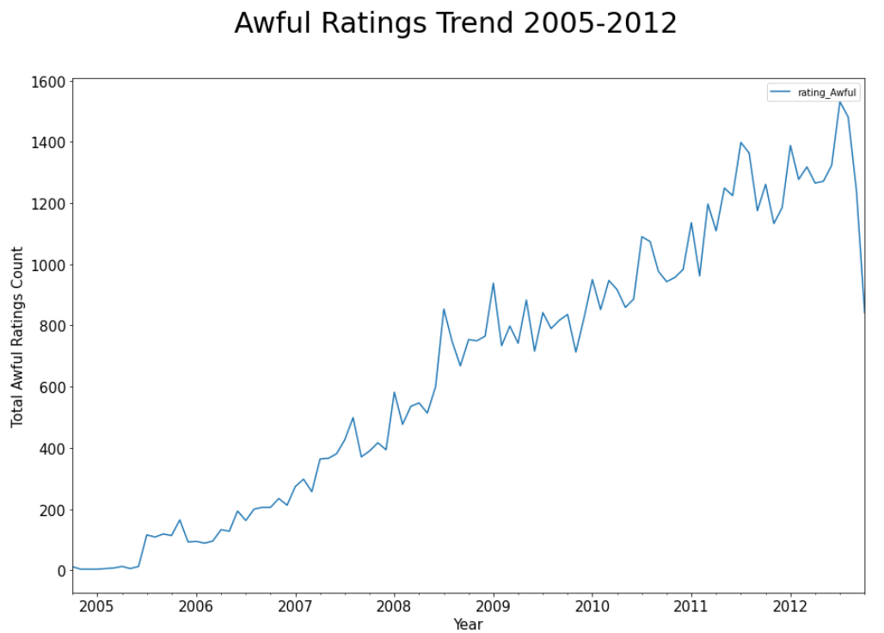
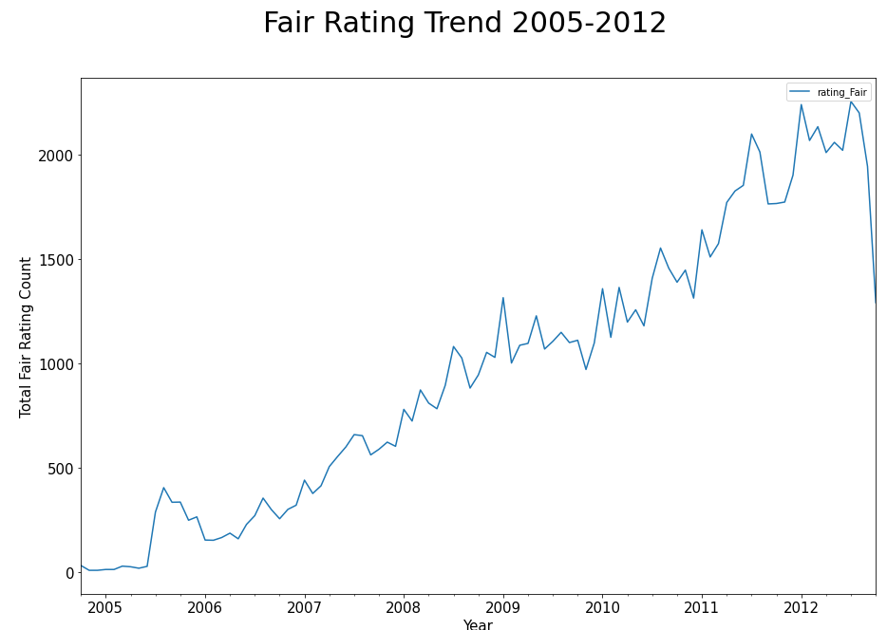
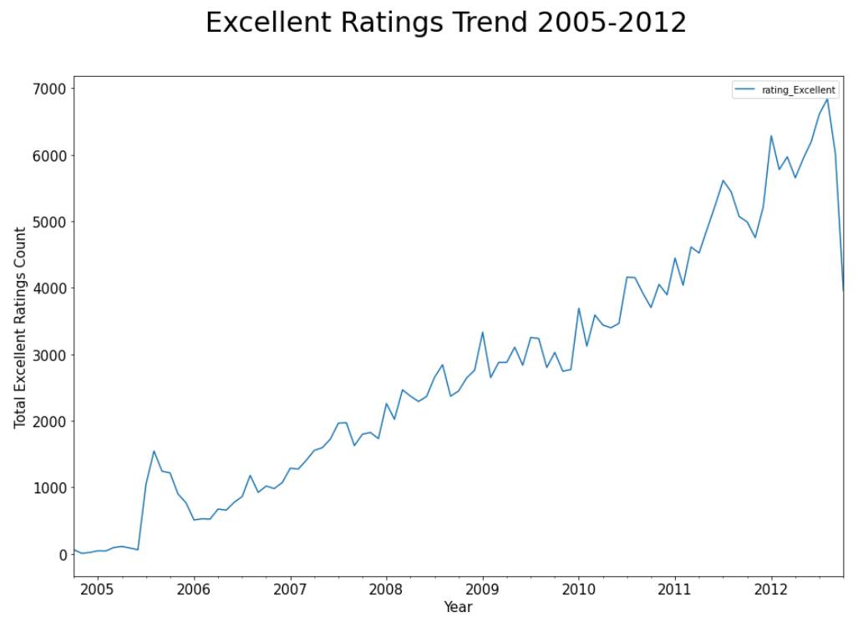
Yelp customer hotel ratings – 7 years trend
Rating – 1-2 Awful, 3 Fair, 4-5 Excellent

Slide 6
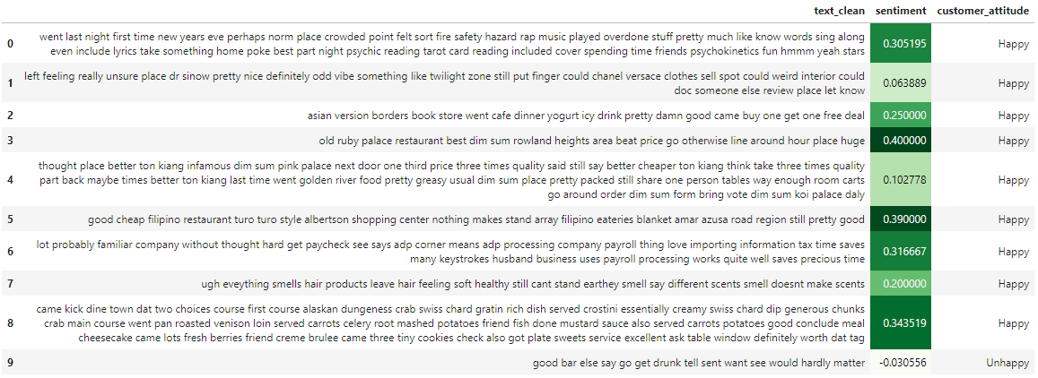
Sentiment analysis on Yelp hotel reviews - happy vs. unhappy customers

Slide 7
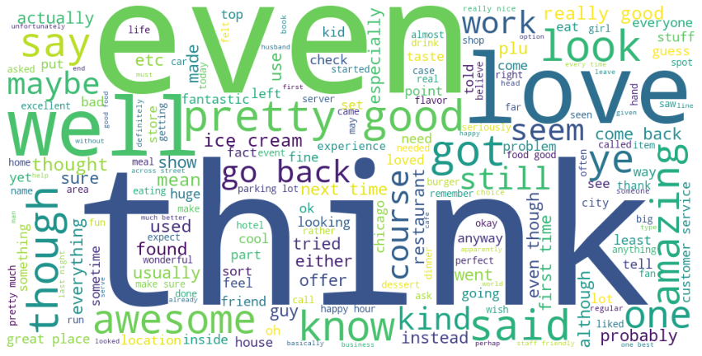
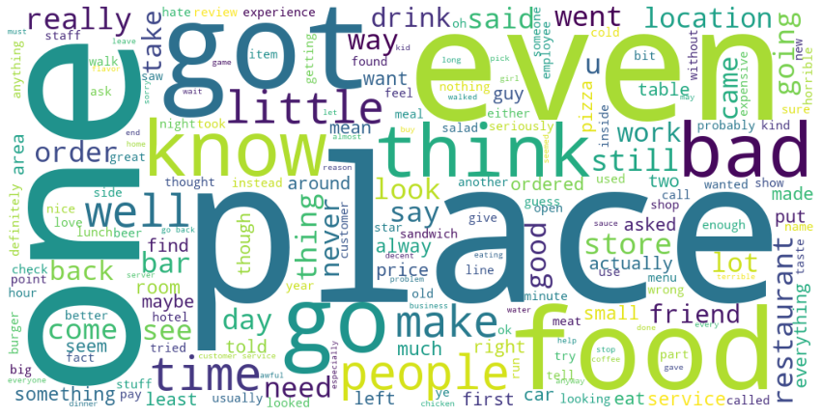
Word cloud on reviews - happy vs. unhappy customers
Happy Customers Keywords
- general impression: good, perfect, amazing
- service: kind, go back, experience, location
- food: ice cream, flavor, good food
Unhappy Customers Keywords
- general impression: bad, little, hate, never
- service: price, staff, time
- food: bar, drink, pizza, burger

Slide 8
LDA Visualizations - Happy vs Unhappy Customers

Slide 9






Focus on common customer review themes
Bar Amenities
Room Amenities
Convenience
Shopping Amenities
Food/dining Amenities
Nightlife Amenities

Slide 10
Are there other characteristics about customers that would be useful to know about?
Reviewers' average rating/sentiment for all reviews
Weight can be calculated based on how significant a reviewer's rating/sentiment deviated from other reviewers' average ratings.
Demographic data
Age
Gender
Time between review and experience
To help determine the intent and accuracy of review/rating
Family status
Income
Business / Leisure

Slide 11

Operational strategy for new branding
Optimizing Restaurant Offerings
Optimizing Staff Operations
Staff Trainings and consider incentivizing high-quality performance/service
Re-examine menu and offerings to further optimize timing of service
Review cleaning processes to ensure kitchen, bar, and rooms are all safe and sanitized
Inspect current vendors to ensure quality of food

Slide 12

Marketing strategy for new branding
Understanding common customer themes can help the business adapt its marketing and operations.
Hotel webpages should be designed to highlight how our hotels outperform competition for across customer value proposition
Customer analytics should track common themes to determine when interventions need to be made
Concierge and guidance materials can be adapted to ensure guests are well informed across topics they care about

